Slide 1
New Mentor Training
Notes:
*************************************************************Activity*******************************************************************
Key Points:
Introduce yourself
Materials Needed: cardstock, markers, sticky notes
Name Tags: Create a name tag and write down 2-4 things that make you uniquely awesome as well as your "why" for becoming a mentor. Share nametag and where they'll be mentoring with group after making.
Time Estimate: 10-20 min (depending on size of group)

Slide 2
Game Plan
By the end of New Mentor Training, you will be able to:
Understand the core values and mission of TeamMates
Abide by TeamMates’s safety policies
Describe the role of a mentor
Apply mentoring best practices
Identify people and resources available for ongoing support
Notes:
Our Goal for today’s training is to get you comfortable with your new role as a mentor:
We will discuss the TeamMates organization and values,
Communicate all the ways we keep students safe,
Describe your role as a mentor,
Discuss some mentoring best practices,
And also help you identify resources for support.

Slide 3
Online Training Agreements
Questions Rock!
Beginner's Mind
Hang Up and Hang Out​
Notes:
You may also use the Chat room, or show reactions at the bottom of your zoom screen
**Raise hand (More button on phones)

Slide 4
What is TeamMates?

Slide 5
Notes:
Key Points:
Brief history of TeamMates
1991; Tom and Nancy Osbourne
190+ Chapters
5 States
Read Mission
As mentors, you are at the front of helping these students reach their full potential. You do this by being there, listening, and encouraging

Slide 6
Core Values
Commitment to Students
Integrity & Trust
Strengths-Based
Safety
Inclusion
Notes:
Key Points:
Commitment to students: We are committed to serving students with compassion and respect. Our role is to ensure we are meeting the needs of our students even if that means extra effort
Safety: The safety of our students is our top priority. It is the reason for the policies we set that we will review later on
Integrity and Trust: The schools we enter and families whose students we mentor are trusting us with the safety of their students. We don't take this lightly. Our job is to serve with integrity and continue to strengthen their trust in us.
Inclusion: TeamMates is a program open to ALL students. Not just "at risk" students or any particular type of student. We welcome all.
Strengths-Based: Strengths-Based means We focus on the innate talent and unique contribution of each individual.

Slide 7
All About Mentoring

Slide 8
Mentoring Expectations
School-based
One-to-one
Weekly meetings
Try for 24+ meetings in the school year
Sign-in and sign-out every meeting
Long term commitment
Notes:
********************************************Activity*******************************************************************
Key Points:
All meetings and communication will happen through the school
Mentoring is one-to-one (siblings, friends, etc -cannot go to match meetings)
Meetings are once a week, with a goal of 24 visits per year. Being present and focused on building the relationship is critical
Be sure to sign-in/log each meeting. This is for safety of you and your mentee and to keep track of your meetings
We are committed to long term investment in students. Not just a few months or a year
Your role is to be a promise keeper to your mentee. This means showing up when you say you will. Having a mentor who doesn't show up or commits for 6 months or less does more damage than if a student never had a mentor at all
Shareout: Discuss how to tell another student that your one-on-one is only for you and your mentee (such as a sibling or friend trying to join)
Have participants "raise hand" in zoom
Trainer will call on participants to share

Slide 9
Types of Mentoring
Developmental
Instrumental
Mentee guiding the activities and time
Learning from mentee
Listening more than talking
Focus on developing trust
Mentor leads​
Having a “fix it” mindset​
Specific goal set for mentoring time​
Relationship is secondary
Notes:
Key Points:
Developmental mentoring is focused on building your relationship with your mentee
Activities should be mentee-led and focused on strengthening trust
Instrumental mentoring is used to fix immediate issues and is mentor-driven
TeamMates subscribes to the developmental model

Slide 10
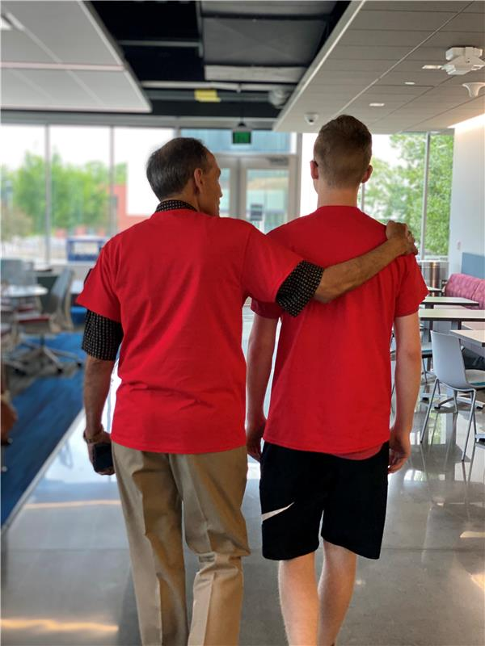
Who Will I Mentor?
TeamMates students are called mentees
Grades 3-12
For ALL kids
Parent permission to participate
Student interest in mentoring
Student trained about the program
Notes:
Key Points:
TeamMates is NOT an "at-risk" program. ALL kids are welcome
Parents must give permission for participation, as well as any additional group activities
Students must also agree to wanting to participate
Mentees go through a brief training

Slide 11
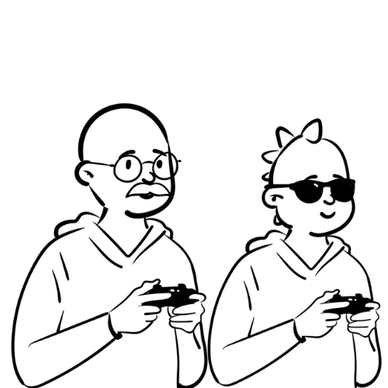
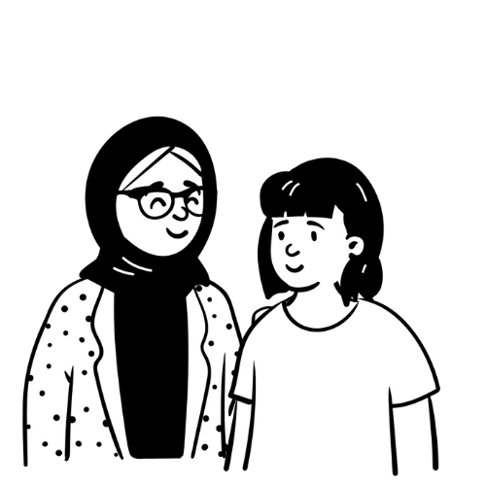
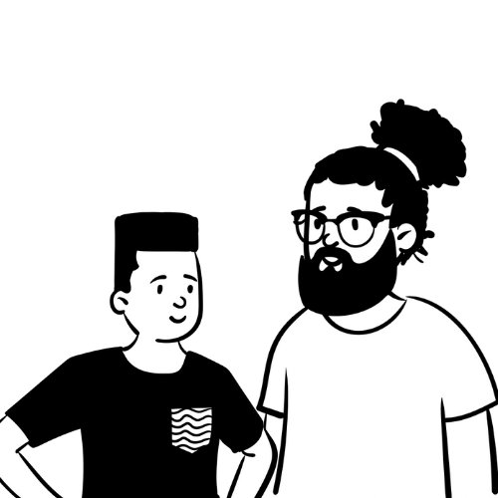
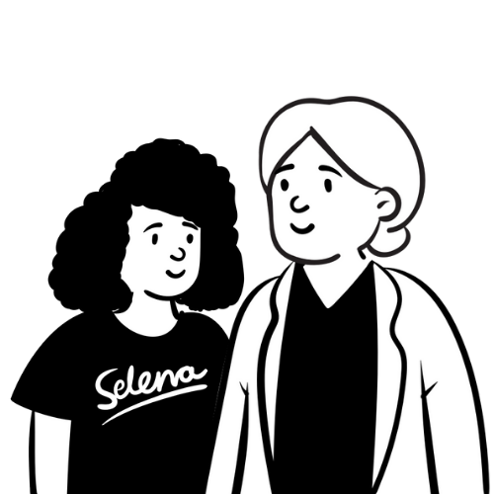
Stages of the Mentoring Relationship
Growth Stage
Mature
Honeymoon
Match Closure
Notes:
*************************************************************Activity*******************************************************************
Key Points:
Honeymoon: This stage is full of excitement and getting to know each other. Set boundaries early to set the tone of the relationship
Growth: Trust is increasing, but this may be a hard stage. Mentees may begin to test boundaries. Still show up!!!
Maturity: Trust has been built and there is more comfort between you and your match. They’ll likely open up more.
Closure: It's so important this is done well. Continue to be present through the end of the relationship and honor the positives of your relationship regardless of the reason for termination. Having a goodbye meeting is critical
**Stages are fluid and can be moved through back and forth multiple times
Sharing: Have experienced mentor share their journey through these stages
- Alternate Activities (if experienced mentor is not available) -
Presenter Share: Examples of existing matches in each stage

Slide 12
Mentor's Role
A Mentor Is
A Mentor Is Not
Notes:
*************************************************************Activity*******************************************************************
Key Points:
It's important to recognize what roles mentors have and which they do not
Send Mentors into breakout rooms to discuss. Have 1 person from each group share aloud

Slide 13
A Mentor is...
Safe
Good listener
Fun
Positive role model
Willing
Strength spotter
Inspirer
Encouraging
Promise keeper
Hope builder
Supportive
Trustworthy
Free
Dependable
Forever friend
Learner
Notes:
Key Points:
A mentor's role is to express care, challenge growth, provide support, share power, and expand possibilities (Research from The Search Institute)
These characteristics you've listed help you to fulfill these responsibilities

Slide 14
A Mentor is Not...
Selfish
Judgmental
An expert
Paid
Social media friend
Uber or taxi driver
Gift giver
Problem solver
Parent
Peer friend
ATM machine
Private investigator
Perfect
Therapist
Notes:
Key Points:
A mentor is not meant to be a parent, a priest, a politician, or a psychologist
A mentor is not meant to be a savior who fixes mentees' problems, but an advocate who connects mentees to resources

Slide 15
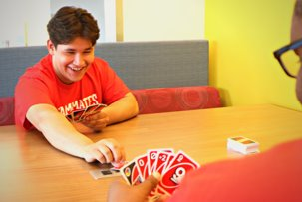
Possible Match Activities
Play board games or card games
Do a craft
Physical Activity - frisbee, shoot hoops
Walk and Talk
Read a book together
Paint or draw
Learn something new
Notes:
*************************************************************Activity*******************************************************************
Key Points:
Activities are meant to be mentee-led, but it's always important to have a few ideas in your back pocket
If your mentee is shy and doesn't know what to do, try to get to know their interests and hobbies and suggest ideas around those
While physical activities are encouraged, you MUST remain on school grounds, and physical contact activities are not allowed
Ex. Shooting hoops is great, one-on-one basketball is not
Whiteboard (or chat): Activities for One-on-Ones

Slide 16
Ready...break!
Notes:
Fun Question (poll):

Slide 17
Relationship-Building Practices

Slide 18
Mentoring Philosophies
Developmental
Express Care
Provide Support
Challenge Growth
Share Power
Expand Possibilities
*The Search Institute
Strengths-Based
Celebrate Growth​
Name strengths​
Identify successes​
Develop Strengths​
Generate hope
Notes:
TeamMates wants our matches to engage in strengths-based, developmental relationships
The Developmental Relationships Framework outlined above was developed by The Search Institute as a way for adults to engage in developmental relationship with youth
As a strengths-based program, we also want our mentors focusing on the strengths of both themselves and their mentees. This list shows a few key actions that show how to put a strengths-based approach into action

Slide 19
Being a Strengths-Based Mentor
Focus on what is right with your mentee
Be a strengths spotter
Encourage your mentee using their strengths
Appreciate your differences
Lead with your own strengths
Notes:
*************************************************************Activity*******************************************************************
Key Points:
Students know the things they feel are wrong with them. Help them to reframe these "flaws"
Our role is to point out what is right with our mentees
Ex. They may think they talk too much --> this ability to communicate is a great strength
Once mentees know their strengths, mentors can help find ways to put these strengths into practice
Everyone has different strengths they bring to the table. This is a great opportunity to learn about each others’ unique qualities and see the value this brings to the relationship
Pair and Share: What are your strengths as a mentor? How will you show up for your mentee and what does that bring to the relationship?

Slide 20
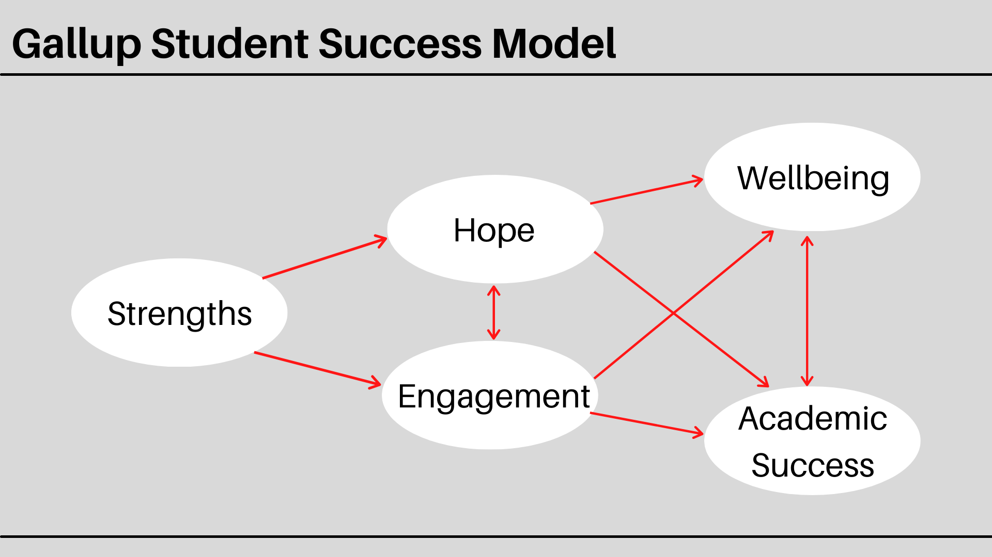
Gallup Student Success Model
Notes:
Key Points:
Revealing strengths to students gives them hope and builds engagement
When students are hopeful and engaged, it increases both their academic success and overall wellbeing
All of these elements are interconnected and it begins with strengths

Slide 21
Building Trust
Be fully present
Be consistent
Be yourself
Listen
Be empathetic
Help create a sense of identity and belonging
Notes:
*************************************************************Activity*******************************************************************
Key Points:
This list may seem simple, but it’s the simple acts repeated consistently over time that begins to build trust
TeamMates research says it takes 3 years to build trust
Reflect and Share: Consider for a moment…Who is someone you deeply trust and why do you trust them?
Have participants share characteristics in the chat box

Slide 22
Exploring Diversity
Diversity refers to any significant differences
You will encounter differences
Youth culture has unique rules
Diversity is a two-way street
Be understanding and nonjudgmental
Notes:
Key Points:
There are natural differences between people (seen and unseen)
You will encounter this with your mentee and it is important to take an open and nonjudgmental approach
It's important to examine your biases that you may or may not be aware of
Doing this helps you better respond with empathy and a desire to learn, rather than judge. The phrase "tell me more" is a great tool for learning

Slide 23
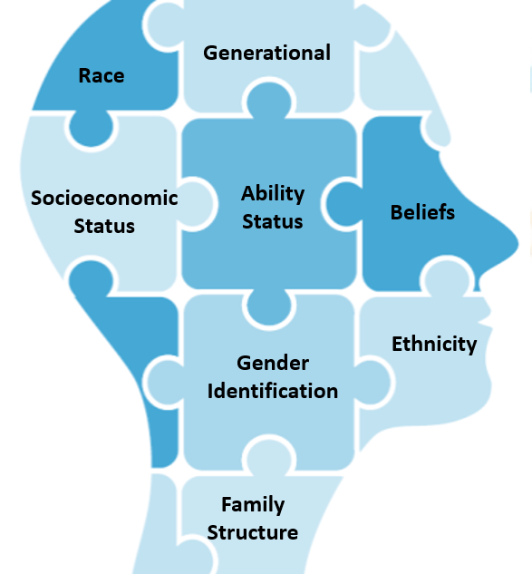
Ways You May Differ
Interests
Values
Goals
Life experiences
Perspective
Strengths
Notes:
*************************************************************Activity*******************************************************************
Key Points:
All of you will experience generational differences
You will also run into other differences. Some visible (race, ethnicity, physical ability, etc) others not visible (moral values, cultural traditions, religion, etc)
Discussion: What are other ways you might differ with your mentee that aren't on this list?
Private Reflection (Emphasize this will NOT be shared with anyone): Facing Diversity Challenges
What difference with a mentee would be most difficult for you to encounter?
How might you handle these differences
***Share that if a mentor needs support or to discuss this further, to reach out to trainers and/or PC/BC after training

Slide 24
Building Identity and Belonging
Express genuine care to your mentee
Respect your mentees boundaries
Strengthen trust between you and your mentee
Create safe spaces
Allow mentee's voice to be heard
Notes:
Key Points:
Everyone needs to feel that they belong
Mentees are figuring out their identity, trying out new hobbies and personalities
Your job as mentors is to encourage and support, not judge
You have the power to show your mentee it's okay to be who they are

Slide 25
Building Growth Mindset
Challenges are an opportunity to learn
Be open to learning new things
Make "yet" statements
Encourage questions
Practice "nexting" with your mentee
Notes:
Key Points:
Adding the word "yet" after the sentence "I'm not good at..." Has so much power
Challenge the "I can't" mentality with questions
This is NOT weakness fixing, it is encouraging mentees to use their strengths to learn and grow in the face of challenges
You can be a model of growth mindset by trying new things your mentee wants to teach you

Slide 26
Ready...break!
Notes:
True Break
When we get back we'll discuss ways to build your relationship with your mentee

Slide 27
Match Boundaries

Slide 28
Safe Environment
School-based
Meet during school day at the school
Public places; doors and blinds open
Schedule meetings in advance
Potential local opportunities
Physical touch
High fives
Fist Bumps
Side Hugs
Notes:
Key Points:
All meetings must take place on school grounds unless it's an approved group activity and parent permission has been received
Group activity example: Zoo day or community parade that your TeamMates chapter is attending together
You are a part of your mentee's outer circle of relationships. Limit physical touch (examples above) to display healthy adult-youth boundaries

Slide 29
Time
Only engage in one weekly meeting
Once a week for 30-60min
Be "in the moment" when meeting
Consistency and frequency is important
Honor TeamMates model
Notes:
Key Points:
Be present in the time you have together (24 meetings = about ½ - 1 day’s worth of time)
You're welcome to attend school events IF your mentee invites you.
Do not structure your schedule around their activities schedule
Stick to the model of once per week
It creates a fair opportunity for all mentees (not all mentors can sacrifice multiple hours a week)

Slide 30
Communication
All communication between mentor and mentee is through the school
Your local coordinator is your go-to person
Do not follow or friend your mentee on any social media platforms
Notes:
Key Points:
Set expectations about no interaction on social media from the start
This is to protect both yours and your mentee's privacy
School-based mentoring = school-based communication (go through your PC/BC)
Texting is permitted for high schoolers with parent permission in school districts that allow it

Slide 31
Gift Giving
Avoid giving gifts
Act as an advocate, not as an ATM
Keep the focus on relationship-building
Notes:
Key Points:
The purpose of TeamMates mentoring is to give our time and show the value of experiences
Gift-giving shifts the focus away from relationship-building
We are models of healthy adult-youth relationships
Gift giving is a grooming tactic used by child predators
Check with PC/BC if you want to bring something (lunch, activity supplies, etc)
Be an advocate, not a hero
If your mentee is in need of something, reach out to the PC/BC to connect them with resources

Slide 32
Self-Disclosure
Relationship is youth-centered not self-centered
Maintain adult-youth relationship
Ask yourself, “Who is this serving?”
Avoid influencing mentee on beliefs
Consider Who? How? What? Method in addressing self-disclosure questions
Notes:
Key Points:
Keep the focus on serving your mentee
Mentors are meant to serve as a caring adult, not influence students with their personal beliefs
Ask yourself: does this conversation serve my mentee or me?
If they're asking you tough questions (ex. Did you drink as a teenager?) redirect them with Who, How, What
Who could better help you answer this?
How could this decision impact you?
What other options do you have?

Slide 33
Parents/Guardians/Families
Be open to the uniqueness of every family
You are the mentor to the youth, not the family
Don't try to "parent" the mentee
Meetings with parent/guardian should include program coordinator
Notes:
Key Points:
Everyone's family dynamics and culture looks different – be open and non-judgmental
Communication with parents should only be conducted through the school
Parents should not be telling you what to talk about with their child
If you are meeting the parents of your mentee, your mentee should be present
This builds trust with your mentee – they won't have to wonder what you said to their parents

Slide 34
Confidentiality
Information about the following must be kept confidential:
School environment
Personal details about mentees and their families
Photos
Identifying information
Nothing about me without me
Notes:
*************************************************************Activity*******************************************************************
Key Points:
Our mentees' privacy and safety is our top concern
Do not share confidential information with others
**This includes photos being posted to social media
Nothing about me without me means we always want to operate as if a mentee is in the room, and they can hear what we are saying. We don’t want to say anything about our mentees that would break their trust if they were to find out about ti

Slide 35
Recognizing Risk
Required Reporting:
Harm to self
Harm to others
Harm by others
Red Flags:
Abrupt changes in behavior that last more than a week
Hinting about problems at home
Unexplained injuries
Sudden withdrawal from friends and hobbies
Notes:
*************************************************************Activity*******************************************************************
Key Points:
Our job is to be an advocate which means listening and noticing if our mentee is facing trouble
There are red flags to watch for that can signal our mentee is at risk
We must report if we hear or notice harm to self, harm to others, or harm by others
Shareout/Chat: What red flags would you look for?
Have participants "raise hand" in zoom
Trainer will call on participants to share

Slide 36
What Should Mentors Do
If you suspect that your mentee is in a situation of risk:
Be a noticer
Listen, don’t interrogate
Report to your Coordinator (mandatory)
They will help you to make appropriate reports
Call TeamMates Safety and Ethics Hotline Number
1-888-788-7727
Notes:
Presenter Note: Each state has different mandatory reporting laws. Share information about your local requirements
Key Points:
Your job is to listen to your mentee and notice anything concerning
Do not interrogate/question your mentee
If you have a concern (whether you have evidence or not) you must report it to your PC – TeamMates policy requires you to report concerns
PC/BC can help determine whether something needs to be reported to CPS or Law Enforcement – every state has different laws
If you're uncertain of what you're noticing, call TeamMates Safety and Ethics Hotline
When in doubt, call the hotline or talk to your Coordinator!

Slide 37
Moving Forward

Slide 38
What’s the Impact?
85% of mentees are more hopeful about their future
90% of mentees are proud to be in TeamMates
92% of mentors leave mentoring time in a better mood
85% of mentors leave mentoring time feeling more hopeful
82% of mentors return to work/home more engaged
Notes:
Key Points:
The work you do matters
Our research has shown this improves mentees' lives as well as mentors'
Video Notes:
**Click "CC" on video for closed captions

Slide 39
You are Part of a Team
Building coordinator
Program coordinator
School staff
Other mentors
Mentor Resource Library
MENTOR
Notes:
Key Points:
Mentoring can feel intimidating when you start, but you are not alone
Your PC/BC/RC and National office staff are here to support you
Click on these BLUE links when you get a chance- (Tori will share powerpoint)
Demo: Mentor Resource Library on website-Bookmark this page on Teammates.org
The Do Good News is a part of the TeamMates homepage: https://dogoodnews.teammates.org This online magazine is full of resources like activities, inspiring stories and overall TeamMates updates.
And Mentor is found at Mentoring.org- you can click on their resources tab for a variety of topics!

Slide 40
What's Next?
Program coordinator will reach out to you
Match survey
Building information
First match meeting
Training survey
Mandatory Refreshers (every 3 years)
Optional Academies (continued training)
Notes:
Key Points:
Your PC/BC will reach out with information regarding the matching process and meeting your mentee
You will receive a training evaluation survey (this helps us continue to improve!)
You will be required to attend Mentor Refreshers- every 3 years
Continued development (academies) will be offered throughout the year
The virtual Academies will be offered live, and then recorded. They're optional but highly encouraged.

Slide 41
Wrap Up
Share one take away
Questions or concerns
Follow us on social media
Notes:
*************************************************Activity******************************************
Key Points:
Please reach out if you still have questions or concerns
We want to thank you for your enthusiasm and energy!
Menti Meter Activity: End of training questions
What is one takeaway from today’s Mentor training?

